Slide 1
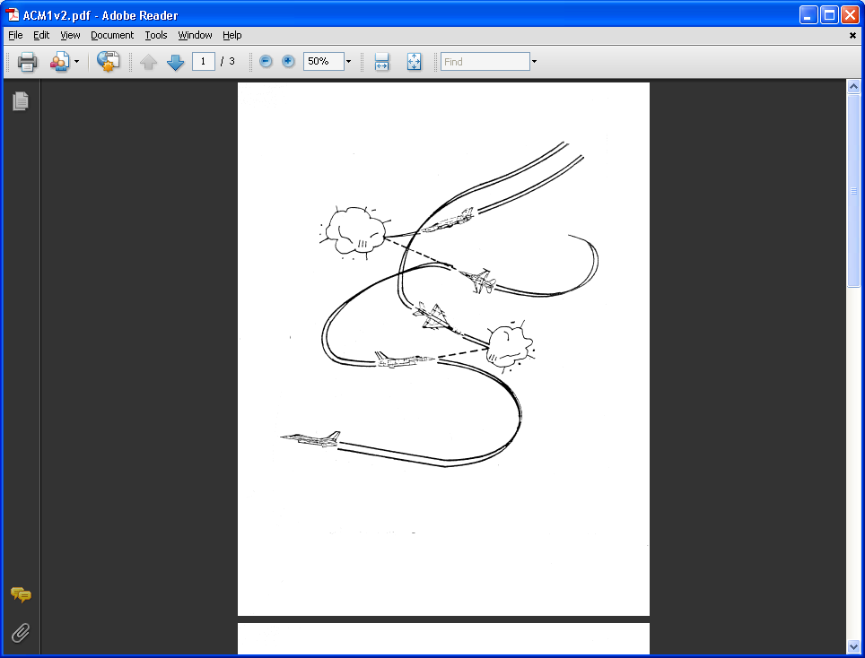
AE 317 Flight Mechanics and Performance
Gliding and Climbing Flight Performance
LECTURE 15
Dr. Jeff Ashworth
Aerospace Engineering Department

Slide 2
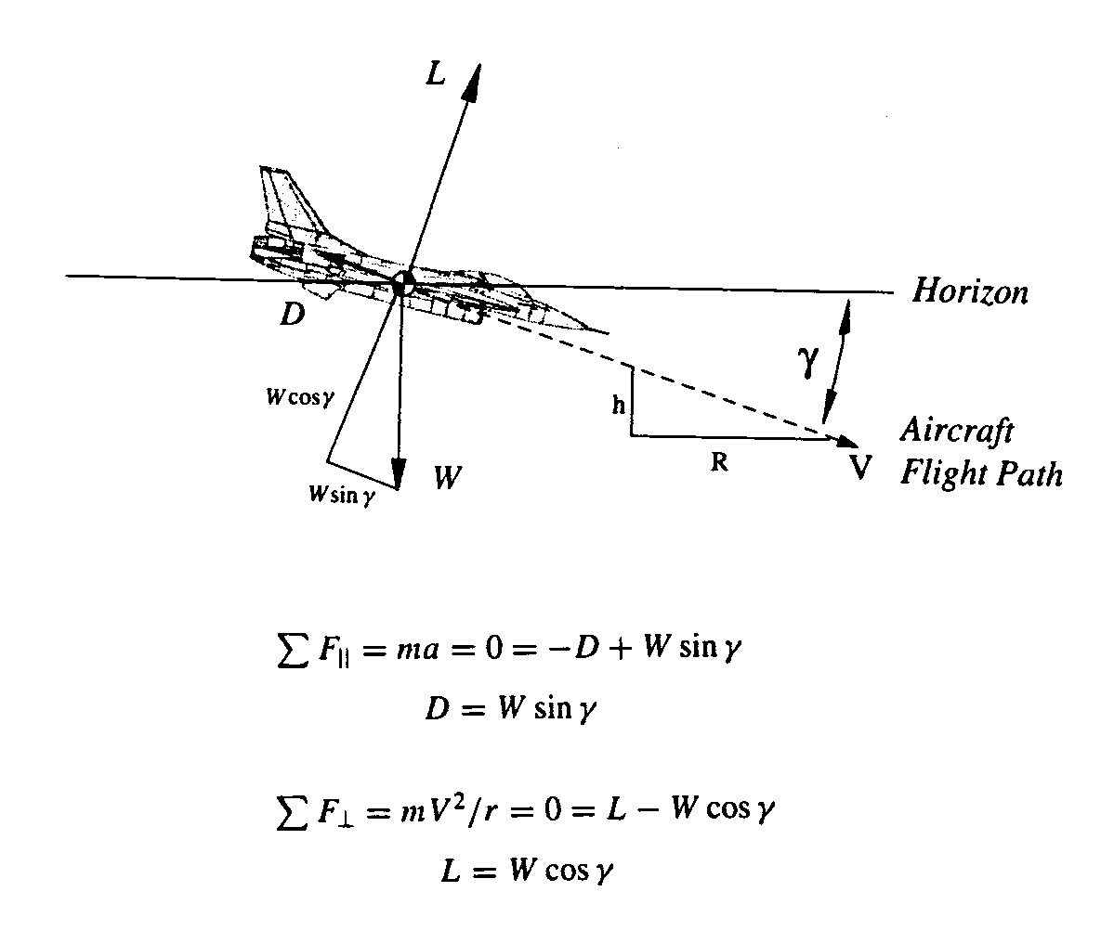
(Brandt)

Slide 3
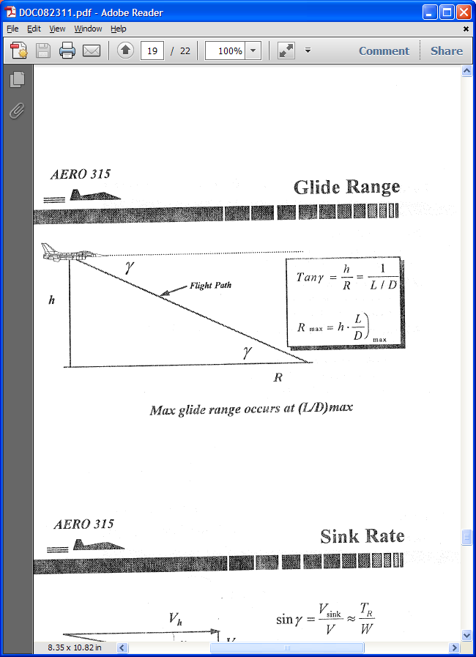
(Brandt)

Slide 4
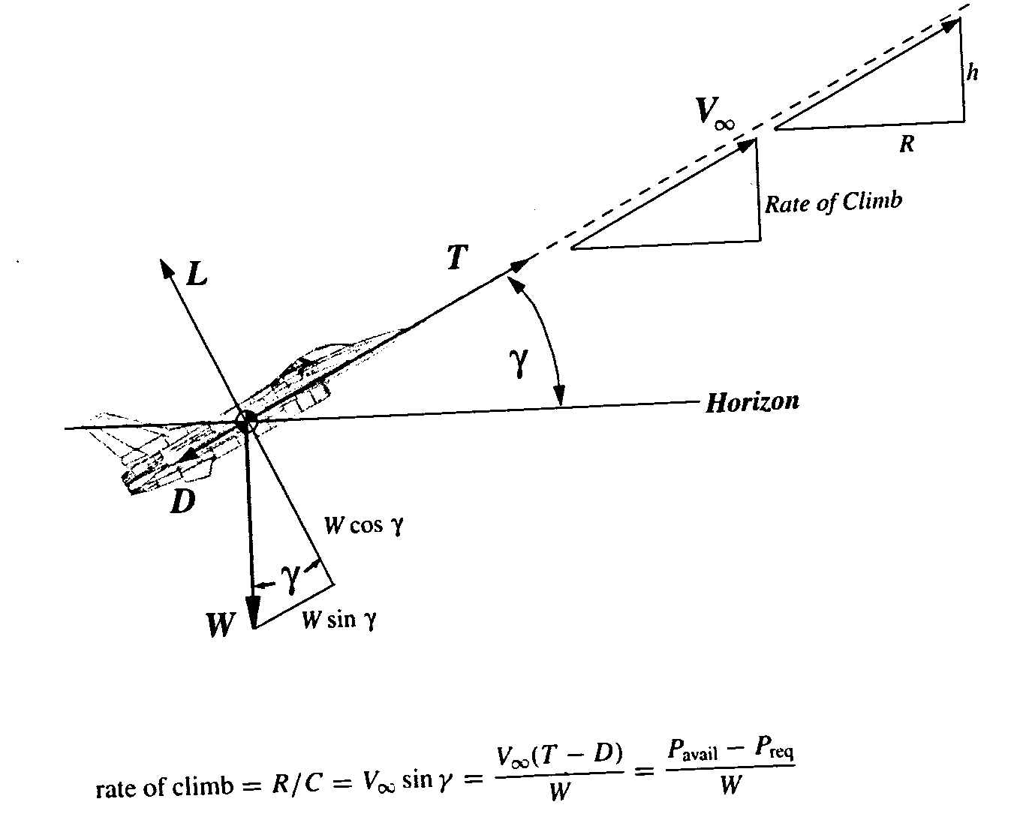
(Brandt)

Slide 5
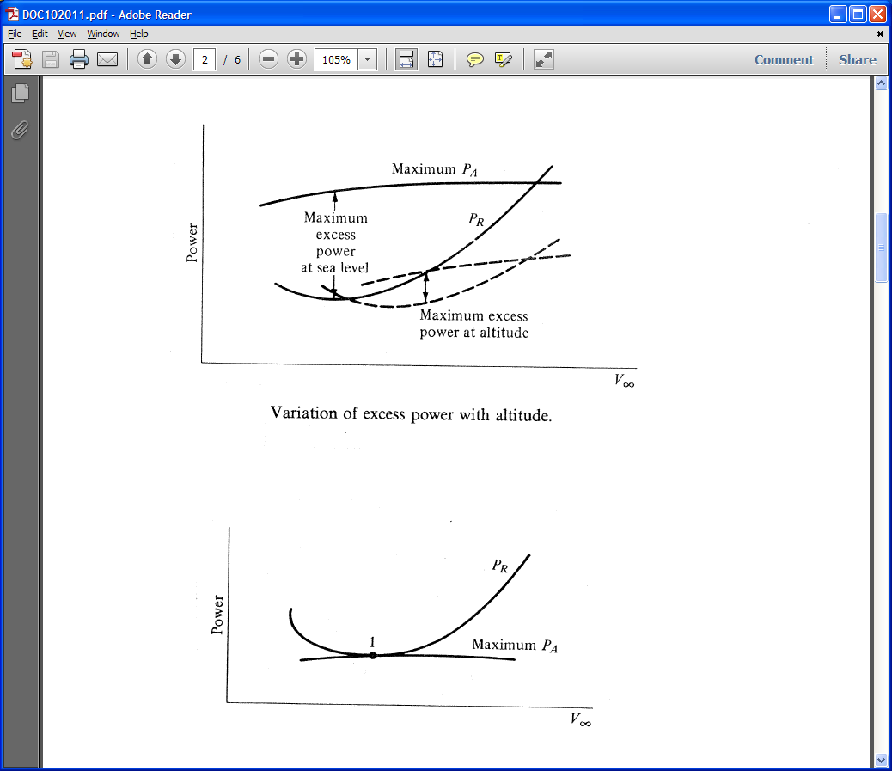
(Anderson)

Slide 6
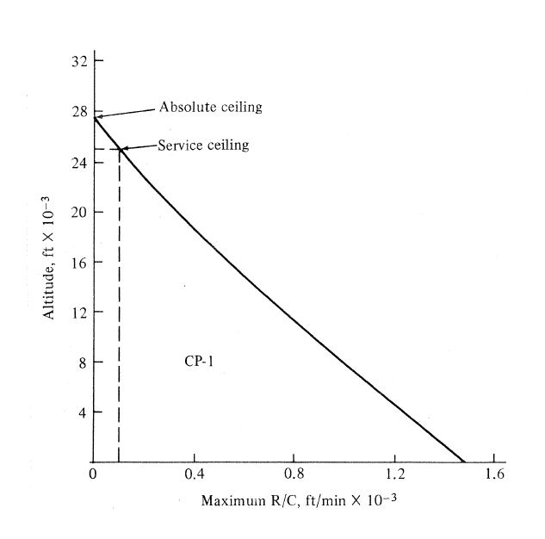
(Anderson)

Slide 7
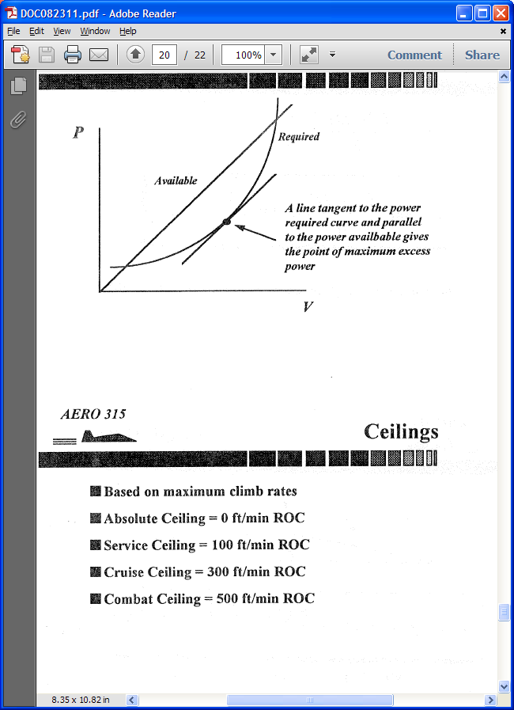
(Brandt)

